Slide 1
Overview of Hands Free Driving System 3
Software Engineering CSE 435
Michigan State University
Fall 2019
Team members:
Project Manager: Ryan LaHaie
Project Facilitator: Hannah Wood
Customer Liaison: Jon Stover
Artifacts Manager: Tony Sulfaro
Security Manager: Andrew Kilponen
Customer: Andrew Davenport, General Motors AI/ML Instructor: Dr. Betty H.C. Cheng*
*Please direct all inquiries to the instructor.
Notes:
Ryan

Slide 2
Project Overview
Provides hands-free highway driving to the user
Steer, accelerate and brake in certain highway conditions
Level 2 autonomous driving features - “hands off”
Utilizes pre-existing lane detection and adaptive cruise control features
Motivation for this project
Enables convenience, efficiency and enhanced safety features
Notes:
Andrew
Intro (Security Manager)
Hands Free Driving System group
This is at level 2 in the path to autonomy - driver is disengaged from physically operating the vehicle by having his or her hands off the steering wheel AND foot off pedal at the same time
Since only lvl 2, we are not required to shift safety-critical functions to the vehicle
Driver still must be engaged and ready to control the vehicle at all times
Builds off of preexisting level 1 technologies to enhance the overall driving experience by improving safety and lessening the burden on the driver
Next I’m going to pass off to Ryan with an overview of some of the features of our system

Slide 3
Overview of Features
Hands-Free Driving System features:
Validates road conditions to ensure safe operation of the vehicle in Hands-Free mode
Maintains an adaptive cruise control state
Keeps the vehicle within the current lane
Monitor the driver’s attention by tracking drivers head and eye movement
Provide warnings and alerts if the driver is inattentive or conditions are unsafe
Notes:
Ryan

Slide 4
Domain Research
Investigated already existing fully autonomous vehicles
Investigated security risks with these existing vehicles
System control
System disengage
Project Constraints
Points of failure must relinquish control
Must be able to identify unexpected behavior
If the driver is deemed inattentive, car slows to a stop and turns on hazards
Security or faulty data must be identified and control relinquished
Notes:
Jon

Slide 5
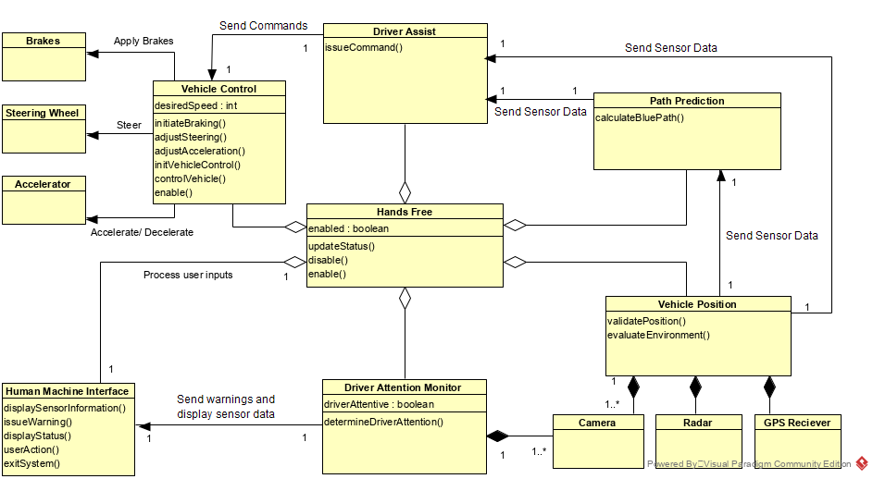
Part II: Model-based View of System
.
Notes:
Hannah

Slide 6
Part III: Demonstration
The Interface resembles a POV of a driver operating the vehicle
Keybindings for accelerator, brake, steering, attention, HFDS toggle
Activate scenarios with number keys 1-4
Sample scenarios
System Fully Operational
System Failure
Driver Inattentive
Driver Override
Notes:
Tony
For our demo we have created a web application that lets users simulate our implementation of a hands-free driving system
The demo itself is a POV from the driver seat
There are keybindings for vehicle functions like accelerate, brake, steer, show attention, and enable HFDS
Keys 1 through 4 demonstrate scenarios in which the driver may find themselves in
System fully operational
System failure (multiple reasons)
Driver Inattentive
Driver override
Let’s demo the program now

Slide 7
Scenario 1: System Fully Operational
Driver is deemed attentive
System steers vehicle within lane
Monitors driver attention

Slide 8
Scenario 2: System Failure
The system encounters a single point of failure
Control of the vehicle is released to the driver
Driver must re-engage with the vehicle

Slide 9
Scenario 3: Driver Inattentive
System detects lack of input from the driver
System issues series of warnings of increasing intensity
Auditory alert
Visual alert
Vibration alert

Slide 10
Scenario 4: Driver Override
System is enabled
Driver takes control of the vehicle, disables HFDS
Presses brake pedal
Presses accelerator
Steers vehicle

Slide 11
Acknowledgements
We gratefully acknowledge and appreciate the participation of our customer, Andrew Davenport from General Motors
We appreciate the support and feedback provided by our instructor, Dr. Betty H.C. Cheng, and our teaching assistants, Duong Nguyen and Kira Chan

